Slide 1
Self-Supervised Approach to Facial Recognition
IDC 409
Grace VL (MS21085)
Sidharth SS (MS21080)
Saju S Mukundan (MS21065)

Slide 2
Objective and Overview
Objective: Build a robust face recognition system using Self-Supervised Learning (SSL)
What is SSL?
Definition: SSL is a method for learning feature representations from unlabeled data.
Relevance to Face Recognition: SSL allows the model to capture distinctive face features without needing labeled images, making it well-suited for scenarios with limited labeled data.
Why SSL?
SSL learns representations from unlabeled data.
Ideal for face recognition where labeled data is scarce.

Slide 3
Advantages of SSL for Face Recognition
Data Efficiency: Uses easily available unlabeled face images for training, saving time and effort compared to labeling data.
Learns Useful Features: The model learns important face features automatically, which can be reused for tasks like face classification.
Reduces Dependence on Labeled Data: Requires very few labeled images for fine-tuning, making it cost-effective.
Handles New Faces Easily: The encoder trained through SSL adapts well to new faces, even from different datasets.
Scalable: Works efficiently with large datasets, improving recognition accuracy as more data is used.

Slide 4
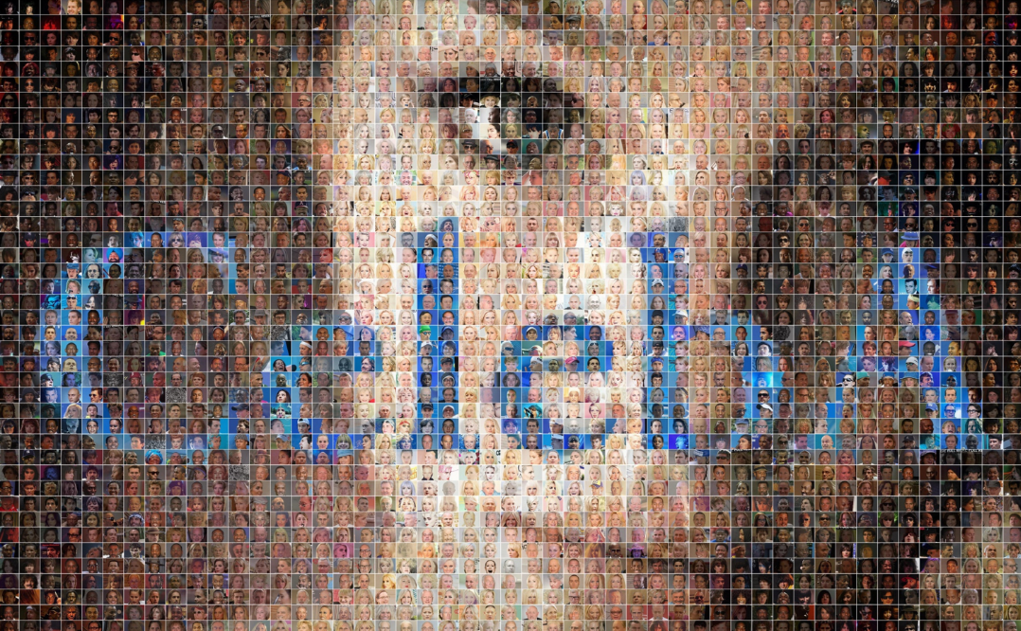
Dataset Preparation
Datasets:
Unlabeled Dataset: Pre-training on CelebA (50,000 images).
Labeled Dataset: Fine-tuning with 17 face classes (each class has 100 images)
Transformations:
Resize to 128x128
Normalize and convert to tensors.

Slide 5
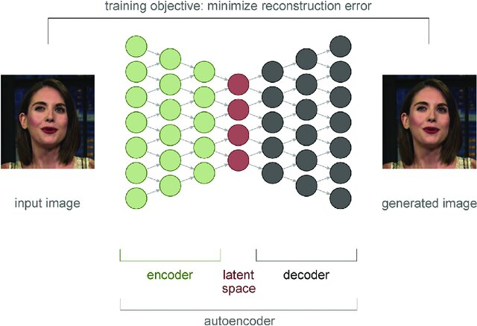

Model Architecture
Encoder:
Extracts face features via convolutional layers.
Decoder:
Reconstructs images for SSL training.
Objective: Train on unlabeled data to learn face representations that can be used for recognition.

Slide 6
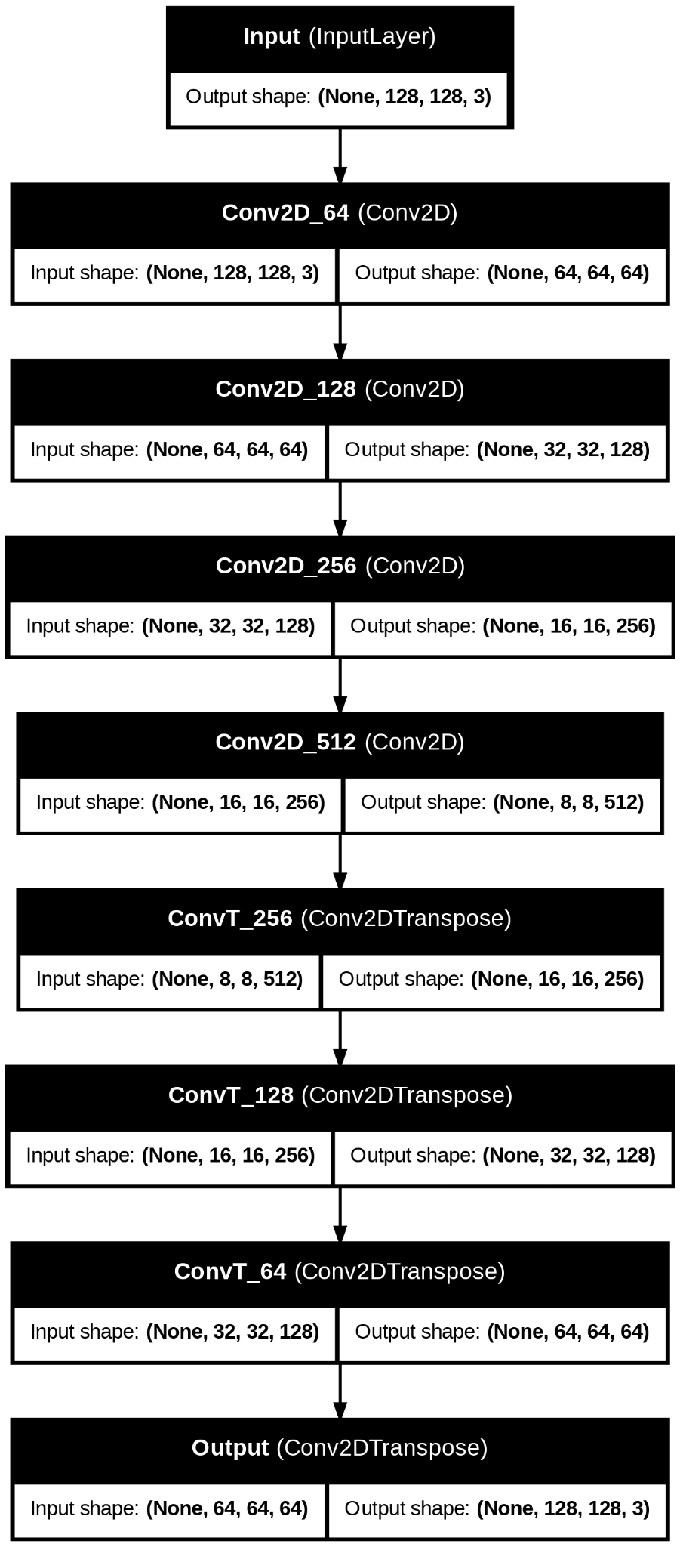
Model Architecture
Autoencoder pipeline

Slide 7
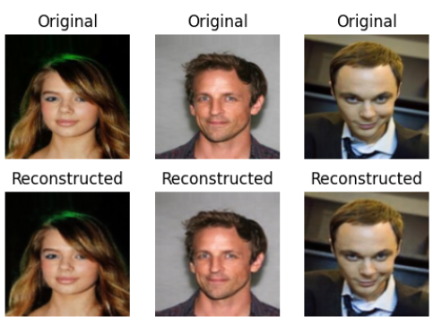
Pre-training
Training Objective: Minimize reconstruction loss (MSE) to improve feature quality.
Training Process:
Feed unlabeled images into the model.
Encoder learns face features by reconstructing images.
Results:
Training loss :0.0012
Cosine Similarity:0.9997

Slide 8
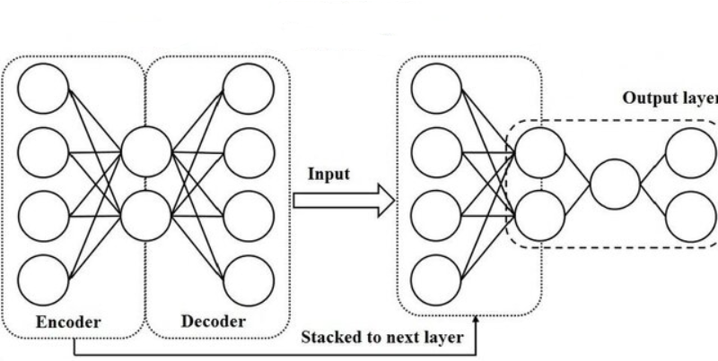
Fine-Tuning for Face Recognition
Classifier Model:
Use encoder from autoencoder as feature extractor.
Add fully connected layer for classification of labeled faces.
Training on Labeled Data: Optimize model with Cross-Entropy Loss, tracking accuracy over epochs.
Data Used: 30% of the labeled dataset (~30 per class).

Slide 9
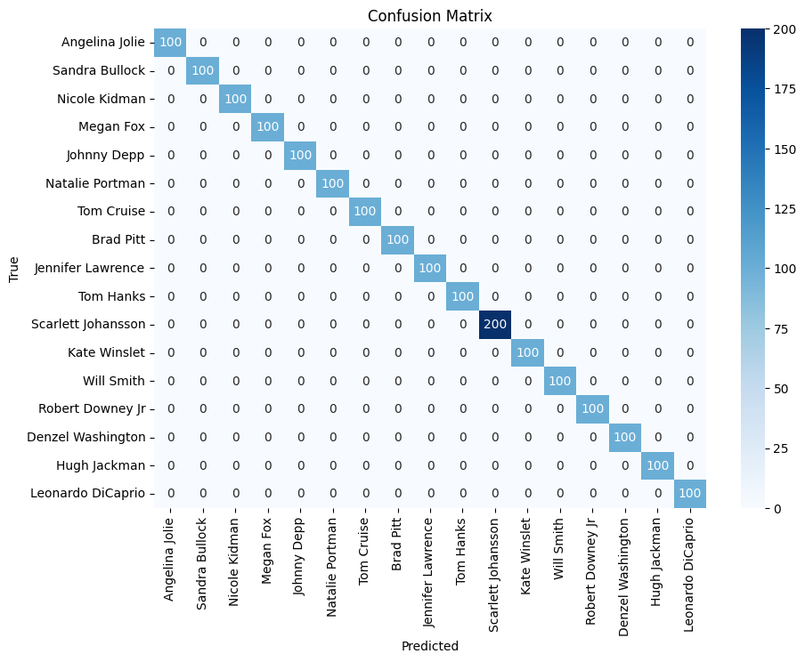
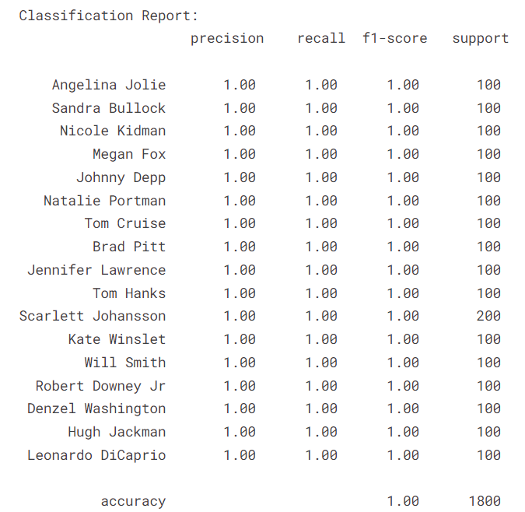
Evaluation Metrics

Slide 10
Saving, Loading, and Utilizing the Model
Model Saving: The trained model is saved as a .pkl file, allowing for easy reusability.
Benefit: Simplifies loading for further testing or deployment, making the model accessible for future use.
Prediction: Once loaded, the model can be used to predict labels for new face images, enabling validation on unseen data.

Slide 11
Future Directions
Larger Datasets: Test the model on a wider range of data to improve generalizability and robustness. Incorporate larger datasets for training during the unsupervised phase to enhance feature learning.
Hyperparameter Tuning: Optimize hyperparameters such as learning rates, batch sizes, and architecture choices to improve model performance.
Alternative SSL Approaches: Experiment with methods like contrastive learning and other self-supervised techniques to enhance feature extraction and representation.
Real-Time Applications: Extend the model for real-time face recognition, integrating it into interactive or live systems for immediate feedback.

Slide 12
References
Datasets:
CelebA Dataset: A large-scale dataset with over 200,000 celebrity images, each labeled with 40 attribute annotations. More information can be found at CelebA Dataset.
Self-Supervised Learning:
Key Papers:
Chen, T., Kornblith, S., Noroozi, M., & Hinton, G. (2020). "A Simple Framework for Contrastive Learning of Visual Representations." In Proceedings of the International Conference on Machine Learning (ICML). Link
Grill, J.-B., Strub, F., Martinez, M., & Michalski, M. (2020). "Bootstrap Your Own Latent: A New Approach to Self-Supervised Learning." In Advances in Neural Information Processing Systems (NeurIPS). Link
Caron, M., Bojanowski, P., Mikolov, T., & Joulin, A. (2018). "Deep Clustering and Optimal Transport." In Proceedings of the International Conference on Machine Learning (ICML). Link
PyTorch Documentation:
Comprehensive resources on model saving/loading and deployment can be found at PyTorch Documentation.

Slide 13
Thank you!

